Slide 1

GitHub Demo by 17l-4181 17L-4351 17L-4130 17l-4147
Using Command Line

Slide 2
What is GIT & Github?
Git is an example of version control.
Version control is a system that records changes to a file or set of files and helps us recall specific versions later if needed. E.g. Subversion (SVN), CVS,Perforce etc.
It allows you to do the following tasks:
Revert the files
Compare the changes over time
User can make any changes without internet access (requires push after you are connected with the internet to see changes)
Track the modification by username
Controlled modifications requiring owners permission
Github is a repository hosting service for git
Github provide a web-based graphical interface working on top of git
Provides basic task management tools

Slide 3
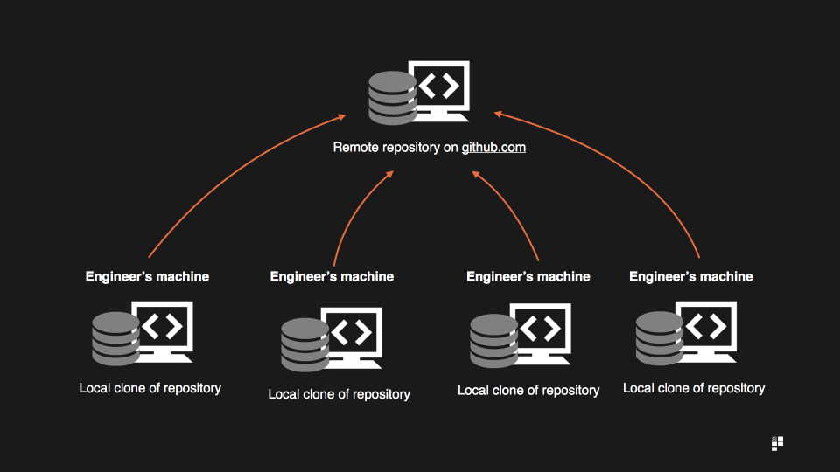
Why git?

Slide 4
Basic Github commands
git init (creates a local repository)
git add . (. is a flag to add all files)
git commit (keeping track of your progress on branch e.g. referencing to previous commit to track how the current commit is different from previous)
git push (add local changes to remote repo by giving origin either your branch name of default master branch like git checkout origin master)
git checkout (for switching the branches)
git merge (merging branch to master branch or in easy words joining two or more development histories)
git pull (to update the local version of repo from the remote repository)
Force flag (e.g. git push –f origin master bypasses the errors and overwrites the data)

Slide 5
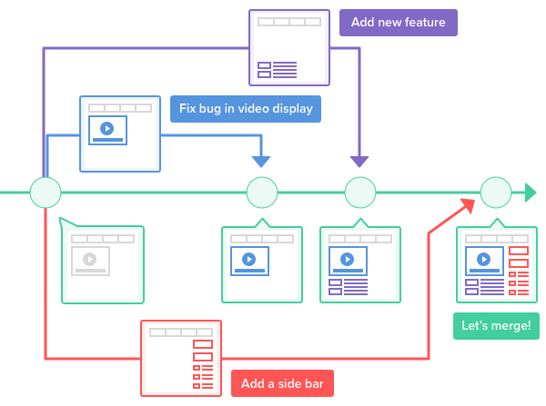
How branching works?

Slide 6
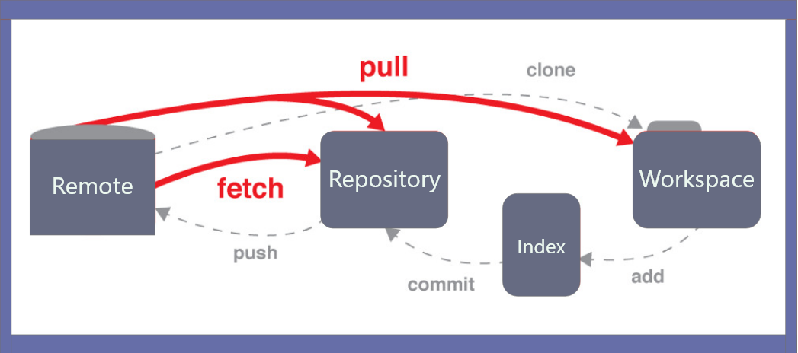
Workflow of GitHub

